Slide 1
Banking Application Case Study

Slide 2
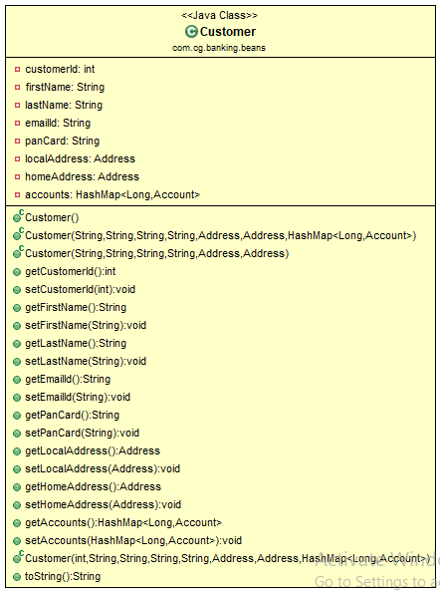
Customer Class Diagram

Slide 3
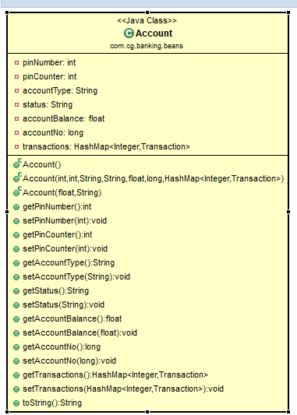
Account Class Diagram

Slide 4
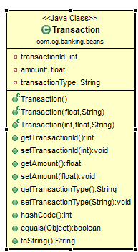
Transaction Class Diagram

Slide 5
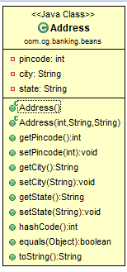
Address Class Diagram

Slide 6
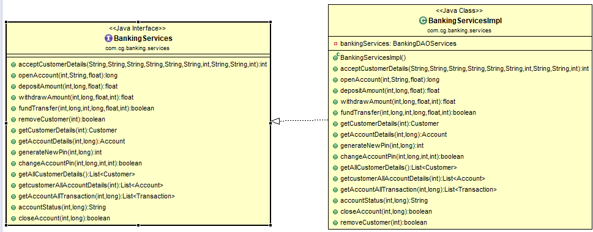
Banking Service Layer

Slide 7
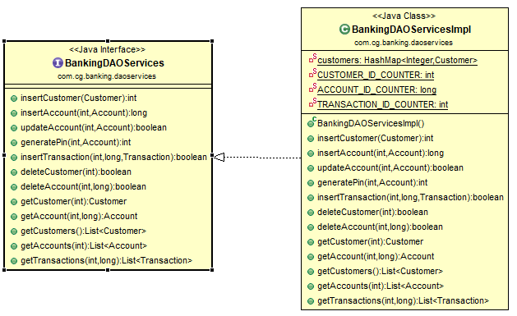
DaoService Layer

Slide 8
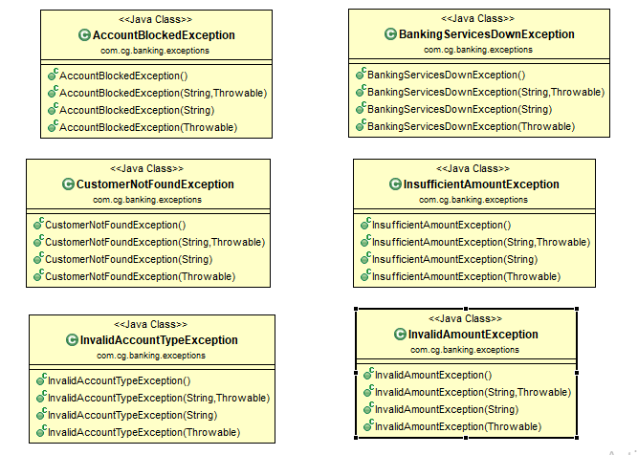
Exception Layer

Slide 9
Thank You
Eee Saaala Cup Namdey

